Slide 1
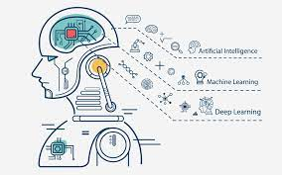

Career in Machine Learning (Industry)

Slide 2
Outlines
Machine Learning Industry.
Machine Learning directions.
Machine Learning jobs.
Pros and Cons of Machine Learning Industry.
How to prepare for a Machine Learning job?
Tips and advice about how to get a Machine Learning position.

Slide 3



Introduction
Montaser Fathelrhman.
BSc Electrical and Electronics Engineering, UofK 2018
MSc Machine Learning, AMMI 2019
Research Assistance, University of Alberta, Canada, 2020
AI Engineer, SonyAI, Tokyo, 2019-2021

Slide 4

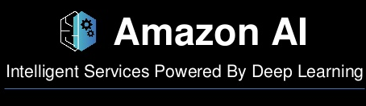






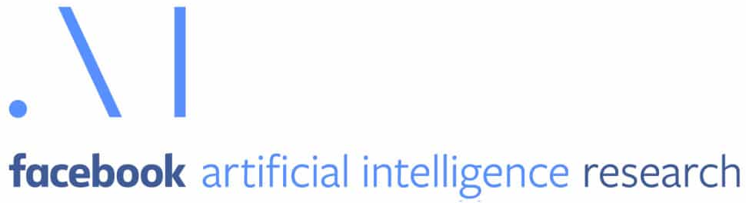

Machine Learning Industry
ML Industry
AI Corporates
Corporates
Mid-sized companies
Start-ups

Slide 5
Machine Learning Jobs
Software Engineer:
Someone with BSc
Design, implement and test software platform
Machine Learning Engineer (Research Engineer)
Someone with MSc.
Conduct a ML research design and implement ML models and papers.
Contribute to scientific papers.
Machine Learning/Data scientist.
Someone with Phd
Experienced in ML.
Leading a research team.
Writing scientific papers.

Slide 6
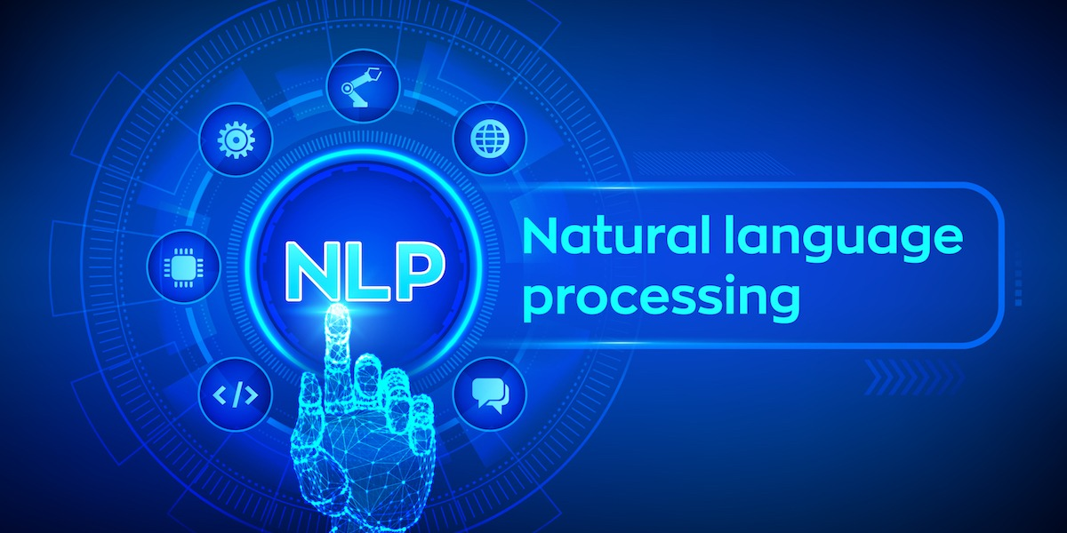

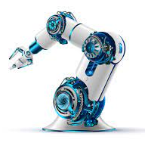


Machine Learning directions
NLP
Computer Vision
Robotics
Finance
Gaming

Slide 7


Pros and Cons of Machine Learning Industry
Resources and computation power.
Money and good Salary.
Interesting problems.
Real-world problems and solution.
Large and experienced Team.
Hard to get.
Focus on developing Vs research
Confidentiality.
Restricted Research directions.
Limited Publications.

Slide 8
Tips and advice about how to get a Machine Learning position
Improve your Coding skills (build projects, git, etc).
Study Math and statistics.
Pick an interesting project and work on it.
Attend online ML courses.
Collaborate with others.
Github profile.
Apply for internships/scholarships.
Attend ML conferences, workshops and events (Black in AI, Women in AI).
Ask for help and advice, don’t be shy!

